Slide 1
Testing throughout the Software Life Cycle
Software Testing
ISTQB / ISEB Foundation Exam Practice
1 Principles
2 Lifecycle
3 Static testing
4 Test design techniques
5 Management
6 Tools
Chapter 2

Slide 2
CONTENT
Software Development Life Cycle Models
Test levels
Test types
Maintenance testing

Slide 3
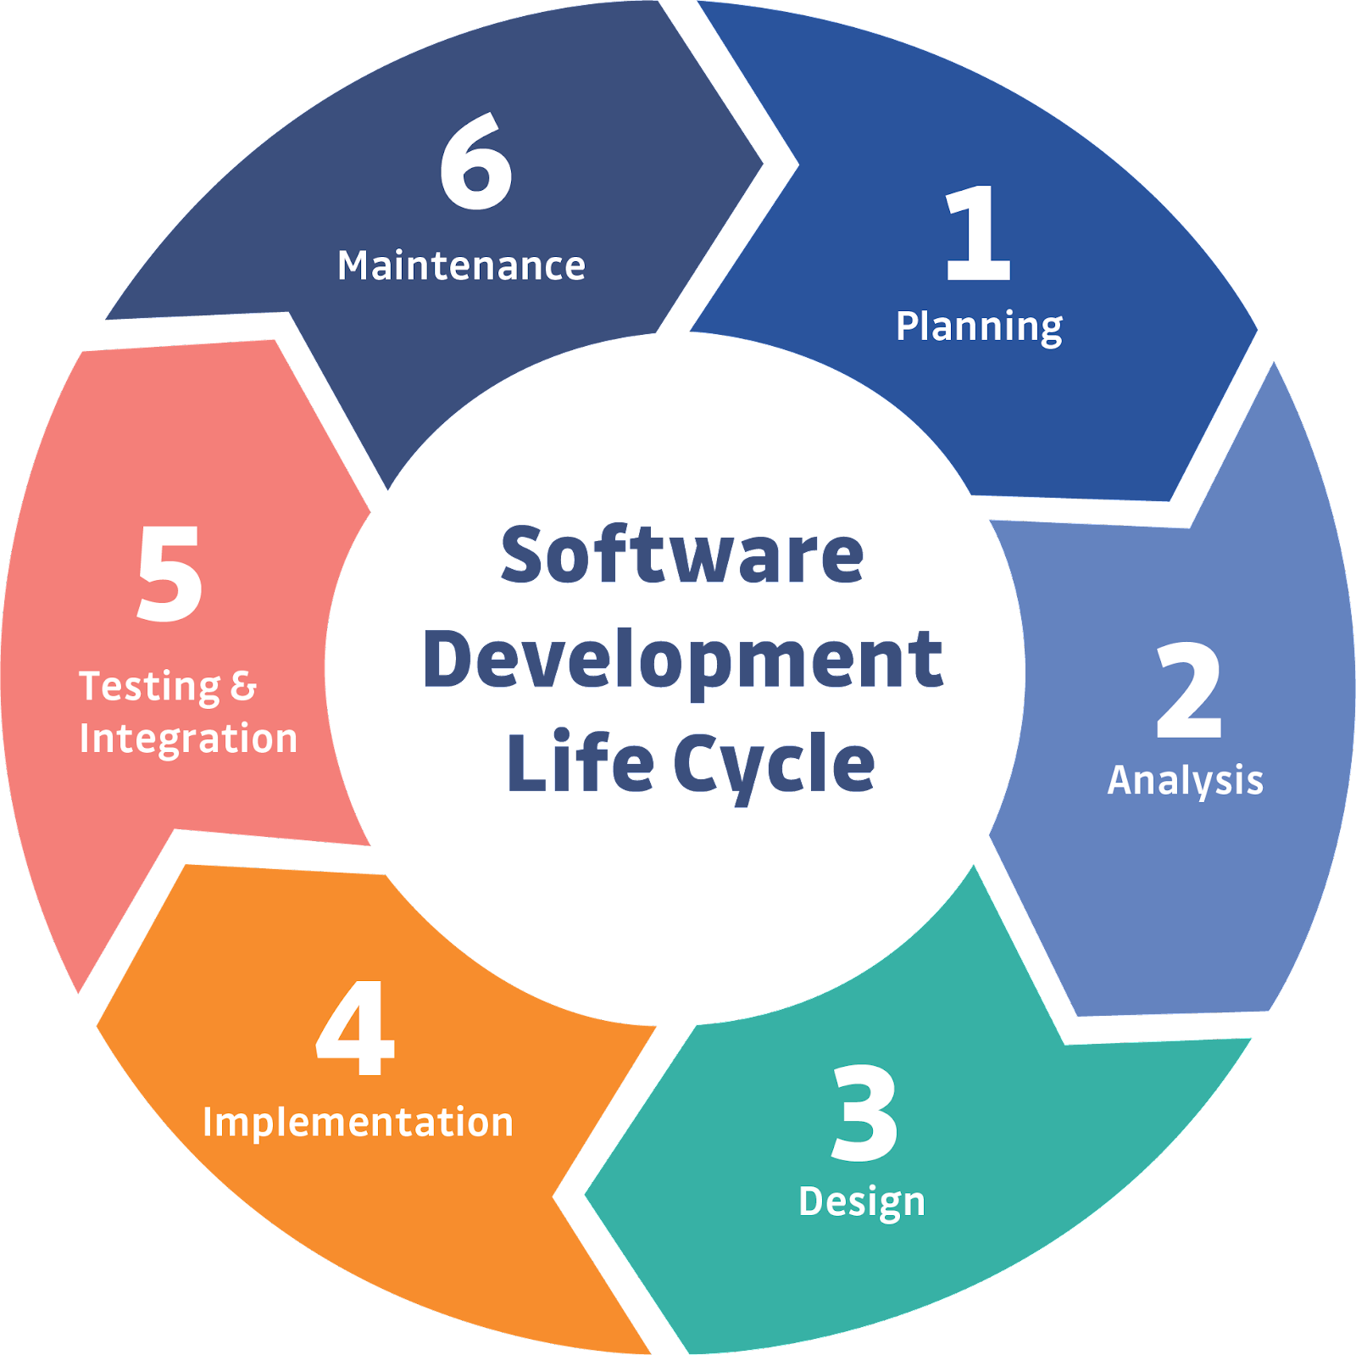
Software Development Lifecycle
A software development lifecycle model describes the types of activity performed at each stage in a software development project, and how the activities relate to one another logically and chronologically.

Slide 4
Characteristics of Good Testing [in any software lifecycle model]
For every development activity, there is a corresponding test activity.
Each test level has test objectives specific to that level.
The analysis & design of tests for a given test level should begin during the corresponding software development activity.
Tester participate in discussion to help define & and refine requirements and design and are involved in reviewing work products.

Slide 5
Software Development Lifecycle Models
SDLC Models
Sequential
Iterative & Incremental

Slide 6
Sequential Development Models
A sequential development model describes the software development process as a linear, sequential flow of activities.
Any phase in the development process should begin when the previous phase is complete.
In theory, there is no overlap of phases, but in practice, it is beneficial to have early feedback from the following phase

Slide 7
Waterfall Model
The development activities are completed one after another.
Testing tends to happen towards the end of the life cycle → defects are detected close to the live deployment date.
It is difficult to get feedback passed backwards up the waterfall & cost of change is high.

Slide 8
V-Model: Test Levels
User Requirements
Acceptance
Testing
Requirements
Software Specifications
System
Testing
High-level
Design
Integration
Testing
Design
Detailed
Design
Component
Testing
Implementation
Testing
Development

Slide 9
V-Model: Late Test Design
User Requirements
Tests
Acceptance
Testing
Software Specifications
Tests
System
Testing
High-level
Design
Tests
Integration
Testing
Detailed
Design
Component
Testing
Tests
Implementation
Design
Tests?

Slide 10
V-Model: Early Test Design
User Requirements
Tests
Acceptance
Testing
Software Specifications
Tests
System
Testing
High-level
Design
Tests
Integration
Testing
Detailed
Design
Tests
Component
Testing
Implementation
Design
Tests
Run
Tests

Slide 11
Early test design
Test design finds faults
Faults found early are cheaper to fix
Most significant faults found first
Faults prevented, not built in
No additional effort, re-schedule test design
Changing requirements caused by test design
Early test design helps to build quality,
stops fault multiplication.

Slide 12
Experience report: Phase 1
Phase 1: Plan
2 mo
2 mo
dev
test
"has to go in"
but didn't work
Actual
fraught, lots of dev overtime
Quality
test
1st mo.
users
not
happy
150 faults
50 faults

Slide 13
Experience report: Phase 2
Phase 1: Plan
2 mo
2 mo
Phase 2: Plan
2 mo
6 wks
Phase 2: Plan
2 mo
6 wks
dev
test
dev
test
dev
test
"has to go in"
but didn't work
acc test: full
week (vs half day)
acc test: full
week (vs half day)
Actual
Actual
Actual
on time
on time
fraught, lots of dev overtime
smooth, not much for dev to do
smooth, not much for dev to do
Quality
test
1st mo.
users
not
happy
Quality
test
1st mo.
Quality
test
1st mo.
happy
users!
150 faults
50 faults
happy
users!
50 faults
0 faults
50 faults
0 faults
Source: Simon Barlow & Alan Veitch, Scottish Widows, Feb 96

Slide 14
VV&T
Verification
the process of evaluating a system or component to determine whether the products of the given development phase satisfy the conditions imposed at the start of that phase [BS 7925-1]
Validation
determination of the correctness of the products of software development with respect to the user needs and requirements [BS 7925-1]
Testing
the process of exercising software to verify that it satisfies specified requirements and to detect faults

Slide 15
Verification, Validation and Testing
Validation
Testing
Any
Verification
Notes:
Ugh. This one…well….

Slide 16
Incremental Development Models
Incremental development involves establishing requirements, designing, building, and testing a system in pieces, which means that the software’s features grow incrementally.
The size of these feature increments vary, with some methods having larger pieces and some smaller pieces.
The feature increments can be as small as a single change to a user interface screen or new query option.
This approach produces working versions of parts of the system early on & each of these can be released to the customer.

Slide 17
Iterative Development Models
Start with a rough product and refine it, iteratively (rework strategy).
Iterations may involve changes to features developed in earlier iterations, along with changes in project scope.
Final version only delivered to customer
in practice, intermediate versions may be delivered to selected customers to get feedback
Each iteration delivers working software which is a growing subset of the overall set of features until the final software is delivered or development is stopped.

Slide 18
Testing in Incremental & Iterative Development
High-level test planning & test analysis occurs at the onset of the project. Detailed test planning, analysis, design, and implementation occurs at the start of each iteration/increment.
Test execution involves overlapping test levels.
Many of the same tasks are performed but with varied timing and extent.
Common issues
More regression testing
Defects outside the scope of the iteration/increment
Less thorough testing

Slide 19
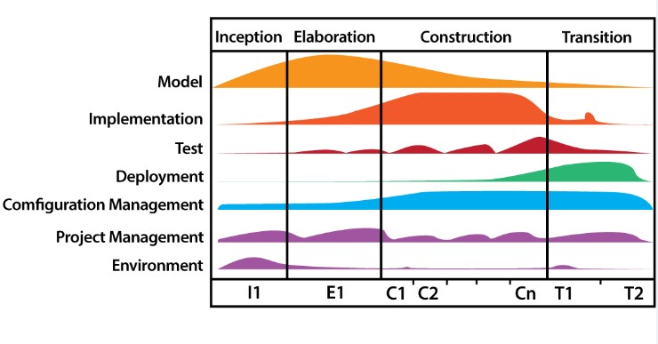
Rational Unified Process (RUP)
Development is iterative with risk being the primary driver for decisions. Evaluation of quality (incl. testing) is continuous throughout development.
Iterations tends to be relatively long (months), and feature increments are correspondingly large (e.g., 2 or 3 groups of related features).

Slide 20
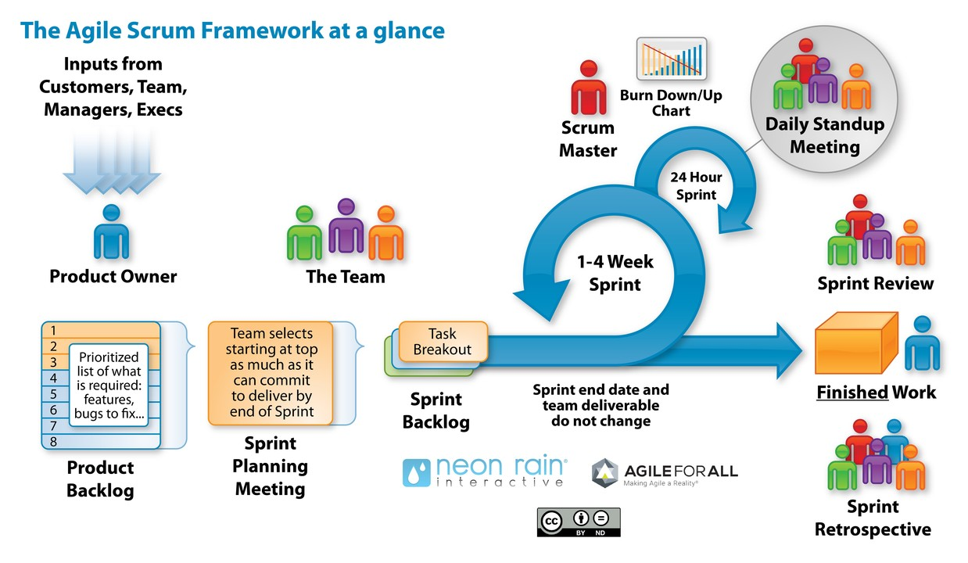
Scrum
Each iteration tends to be relatively short (e.g., days, or a few weeks). Feature increments are correspondingly small (a few enhancements and/or two or three new features).
Notes:
Both incremental & iterative

Slide 21
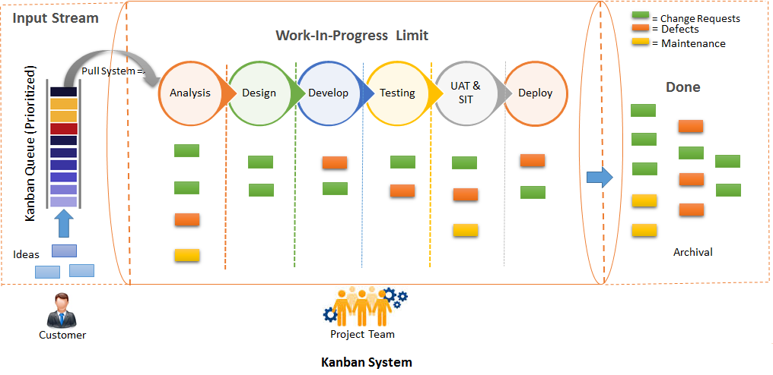
Kanban
Implemented with or without fixed-length iterations, which can deliver either a single enhancement or feature upon completion, or can group features together to release at once.
Key principle: to have a limit for work-in-progress (WIP) activities.

Slide 22
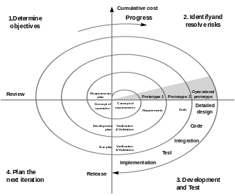
Spiral (or Prototyping)
Involves creating experimental increments, some of which may be heavily re-worked or even abandoned in subsequent development work.

Slide 23
Agile development
Generation of business stories to define the functionality.
On-site customer for continual feedback and to define & perform functional acceptance testing.
Pair programming and shared code ownership amongst the developers.
Component test scripts shall be written before the code is written (TDD) and that those tests should be automated.
Simplicity: building only what is necessary, not everything we can think of.
Continuous integration & testing of the code throughout the sprint, at least once a day.

Slide 24
Agile development: Benefits for Testers
Focus on working software & good quality code
Inclusion of testing as part of & starting point of SWD
Accessibility of business stakeholders → Qs on systems resolved
Self-organising team → more autonomy for testers
Design simplicity → easier to test

Slide 25
Agile development: Challenges for Testers
Different kind of test basis – less formal & subject to change
Misperception that testers are not needed
Different roles of tester – more like coaches
(Usual) constant time pressure
Risk of inadequate automated regression suite

Slide 26
CONTENT
Software Development Life Cycle Models
Test levels
Test types
Maintenance testing

Slide 27
(Before planning for a set of tests)
Set organisational test strategy
Identify people to be involved (sponsors, testers, QA, development, support, etc.)
Examine the requirements or functional specifications (test basis)
Set up the test organisation and infrastructure
Defining test deliverables & reporting structure
See: Structured Testing, an introduction to TMap®, Pol & van Veenendaal, 1998

Slide 28
High level test planning
What is the purpose of a high level test plan?
Who does it communicate to? – all parties involved
Why is it a good idea to have one?
What information should be in a high level test plan?
What is your standard for contents of a test plan?
Have you ever forgotten something important?
What is not included in a test plan?

Slide 29
High-level Test Plan
1. Test Plan Identifier
2. Introduction
Software items and features to be tested
References to project authorisation, project plan, QA plan, CM plan, relevant policies & standards
3. Test items
Test items including version/revision level
How transmitted (net, disc, CD, etc.)
References to software documentation
Source: ANSI/IEEE Std 829-1998, Test Documentation

Slide 30
High-level Test Plan (cont.)
4. Features to be tested
Identify test design specification / techniques
5. Features not to be tested
Reasons for exclusion

Slide 31
High-level Test Plan (cont.)
6. Approach
activities, techniques and tools
detailed enough to estimate (cost?)
specify degree of comprehensiveness (e.g. coverage) and other completion criteria (e.g. faults)
identify constraints (environment, staff, deadlines)
7. Item Pass/Fail Criteria
8. Suspension criteria and resumption criteria
for all or parts of testing activities
which activities must be repeated on resumption

Slide 32
High-level Test Plan (cont.)
9. Test Deliverables
Test plan
Test design specification
Test case specification
Test procedure specification
Test item transmittal reports
Test logs
Test incident reports
Test summary reports

Slide 33
High-level Test Plan (cont.)
10. Testing tasks
including inter-task dependencies & special skills
11. Environment
physical, hardware, software, tools
mode of usage, security, office space
12. Responsibilities
to manage, design, prepare, execute, witness, check, resolve issues, providing environment, providing the software to test

Slide 34
High-level Test Plan (cont.)
13. Staffing and Training Needs
14. Schedule
test milestones in project schedule
item transmittal milestones
additional test milestones (environment ready)
what resources are needed & when
15. Risks and Contingencies
contingency plan for each identified risk
16. Approvals
names and when approved

Slide 35
Test Levels
Test levels are groups of test activities that are organized and managed together.
Each test level (test stage) is a specific instantiation of a test process.
Test levels are related to other activities within the software development lifecycle.

Slide 36
Test Levels: Characteristics
Test levels are characterized by the following attributes:
Specific test objectives
Test basis, referenced to derive test cases
Test object (i.e., what is being tested)
Typical defects and failures
Specific approaches and responsibilities

Slide 37
Test Levels: Environment
For every test level, a suitable test environment is required.
In component testing, developers often use their dev environment.
In system testing, an environment may be needed with particular external connection.
In acceptance testing, a production-like test environment is ideal.

Slide 38
Component Testing
Lowest level
Tested in isolation – use of stubs and/or drivers
Most thorough look at detail
Error handling
Interfaces
Also known as unit, module, program testing

Slide 39
Component Testing
Objectives | Reduce risk. Verify functional & non-functional behaviours. Build confidence. Find defects. Prevent defects.
Test Basis | Detailed design. Code. Data model. Component specifications.
Test Objects | Component, unit, modules. Code & data structure. Classes. Database models.
Typical Defects & Failures | Incorrect functionality. Data flow problems. Incorrect code or logic.
Approaches & Responsibilities | Test-driven development (TDD). Usually done by developer

Slide 40
Component Testing: Test Driven Development
FAIL
TDD
RE-FACTOR
PASS
Developing automated test cases → building and integrating small pieces of code → executing the component tests, correcting any issues, and re-factoring the code.

Slide 41
Component test strategy 1
specify test design techniques and rationale
from Section 3 of the standard*
specify criteria for test completion and rationale
from Section 4 of the standard
document the degree of independence for test design
component author, another person, from different section, from different organisation, non-human
*Source: BS 7925-2, Software Component Testing Standard

Slide 42
Component test strategy 2
component integration and environment
isolation, top-down, bottom-up, or mixture
hardware and software
document test process and activities
including inputs and outputs of each activity
affected activities are repeated after any fault fixes or changes
project component test plan
dependencies between component tests

Slide 43
Test design techniques
✓
Also a measurement technique?
= Yes
✘
= No
“Black box”
Equivalence partitioning
Boundary value analysis
State transition testing
Cause-effect graphing
Syntax testing
Random testing
How to specify other techniques
“White box”
Statement testing
Branch / Decision testing
Data flow testing
Branch condition testing
Branch condition combination testing
Modified condition decision testing
LCSAJ testing
✓
✓
✓
✓
✓
✓
✓
✓
✓
✘
✓
✘
✓
✓

Slide 44
Integration Testing
Integration testing focuses on interactions between components or systems.
Component Integration
Integration
Testing
System Integration

Slide 45
Integration Testing
Component integration tests and system integration tests should concentrate on the integration itself.
If integrating module A with module B, tests should focus on the communication between the modules, not the functionality of the individual modules, as that should have been covered during component testing.
If integrating system X with system Y, tests should focus on the communication between the systems, not the functionality of the individual systems, as that should have been covered during system testing.

Slide 46
Integration Testing
Component integration testing is often the responsibility of developers.
System integration testing is generally the responsibility of testers.
To simplify defect isolation and detect defects early, integration should normally be incremental.
The greater the scope of integration, the more difficult it becomes to isolate defects to a specific component/system → continuous integration (i.e., software is integrated on a component-by-component basis)

Slide 47
Integration Testing
Objectives | Reduce risk. Verify functional & non-functional behaviours of interfaces. Build confidence. Find defects. Prevent defects.
Test Basis | Software & system design. Sequence diagrams. Interface & communication protocol specs. Use cases. Workflows.
Test Objects | Subsystems. Databases. Infrastructure. Interfaces. APIs. Microservices.
Typical Defects & Failures | Incorrect data. Incorrect timing. Interface mismatch. Communication failures b/w components. Incorrect assumptions
Approaches & Responsibilities | Big-bang. Incremental (top-down, bottom-up, functional)

Slide 48
Big-Bang Integration
In theory:
if we have already tested components why not just combine them all at once? Wouldn’t this save time?
(based on false assumption of no faults)
In practice:
takes longer to locate and fix faults
re-testing after fixes more extensive
end result? takes more time

Slide 49
Incremental Integration
Baseline 0: tested component
Baseline 1: two components
Baseline 2: three components, etc.
Advantages:
easier fault location and fix
easier recovery from disaster / problems
interfaces should have been tested in component tests, but ..
add to tested baseline

Slide 50
Top-Down Integration
Baselines:
baseline 0: component a
baseline 1: a + b
baseline 2: a + b + c
baseline 3: a + b + c + d
etc.
Need to call to lower level components not yet integrated
Stubs: simulate missing components
a
a
b
b
c
c
d
d
e
e
f
f
g
g
h
h
i
i
j
j
k
l
m
n
o

Slide 51
Stubs
Stub (Baan: dummy sessions) replaces a called component for integration testing
Keep it Simple
print/display name (I have been called)
reply to calling module (single value)
computed reply (variety of values)
prompt for reply from tester
search list of replies
provide timing delay

Slide 52
Pros & cons of top-down approach
Advantages:
Critical control structure tested first and most often
Can demonstrate system early (show working menus)
Disadvantages:
Needs stubs
Detail left until last
May be difficult to "see" detailed output (but should have been tested in component test)
May look more finished than it is

Slide 53
Bottom-up Integration
Baselines:
baseline 0: component n
baseline 1: n + i
baseline 2: n + i + o
baseline 3: n + i + o + d
etc.
Needs drivers to call the baseline configuration
Also needs stubs for some baselines
a
b
b
c
d
e
f
g
d
h
h
i
i
j
j
k
l
m
n
o
n
o

Slide 54
Drivers
Driver (Baan: dummy sessions): test harness: scaffolding
Specially written or general purpose (commercial tools)
invoke baseline
send any data baseline expects
receive any data baseline produces (print)
Each baseline has different requirements from the test driving software.

Slide 55
Pros & cons of bottom-up approach
Advantages:
lowest levels tested first and most thoroughly (but should have been tested in unit testing)
good for testing interfaces to external environment (hardware, network)
visibility of detail
Disadvantages
no working system until last baseline
needs both drivers and stubs
major control problems found last

Slide 56
Minimum Capability Integration (aka. Functional)
Baselines:
baseline 0: component a
baseline 1: a + b
baseline 2: a + b + d
baseline 3: a + b + d + i
etc.
Needs stubs
Shouldn't need drivers (if top-down)
a
a
b
b
c
c
d
e
f
g
d
e
h
i
h
i
j
k
l
m
j
n
o
n
o

Slide 57
Pros & cons of Minimum Capability
Advantages:
Control level tested first and most often
Visibility of detail
Real working partial system earliest
Disadvantages
Needs stubs

Slide 58
Thread Integration (also called functional)
Order of processing some event determines integration order
Interrupt, user transaction
Minimum capability in time
Advantages:
Critical processing first
Early warning of performance problems
Disadvantages:
may need complex drivers and stubs
a
b
b
c
c
d
e
f
g
d
e
f
g
h
h
i
i
j
j
k
k
l
l
m
m
n
o

Slide 59
Integration Guidelines
Minimise support software needed
Integrate each component only once
Each baseline should produce an easily verifiable result
Integrate small numbers of components at once
one at a time for critical or fault-prone components
combine simple related components

Slide 60
Integration Planning
Integration should be planned in the architectural design phase
The integration order then determines the build order
Components completed in time for their baseline
Component development and integration testing can be done in parallel - saves time

Slide 61
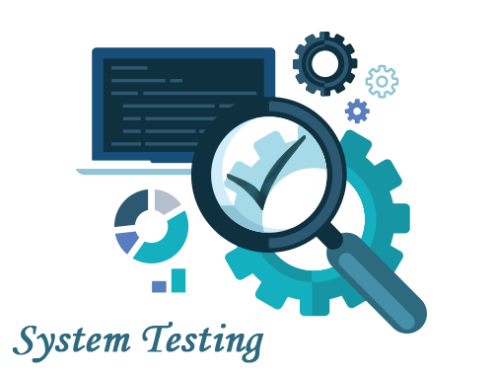
System Testing
System testing focuses on the behaviour and capabilities of a whole system or product, often considering the end-to-end tasks the system can perform and the non-functional behaviours it exhibits while performing those tasks.

Slide 62
System Testing
Objectives | Reduce risk. Verify functional & non-functional behaviours of system. Validate system is complete & as expected. Build confidence. Find & Prevent defects.
Test Basis | Software & system reqs specs. Risk analysis reports. Use cases. Epics & user stories. System models. State diagrams. System & User manuals.
Test Objects | Applications. Hardware/software. Operating system. SUT. System configuration & config data.
Typical Defects & Failures | Incorrect calculations. Incorrect/unexpected system (non-)functional behaviours. Incorrect data flows. Cannot complete end-to-end tasks. Not as described in manuals.

Slide 63
System Testing
Last integration step
Functional
functional requirements and requirements-based testing
business process-based testing
Non-functional
as important as functional requirements
often poorly specified
must be tested
Often done by independent test group

Slide 64
Functional System Testing
Functional requirements
a requirement that specifies a function that a system or system component must perform (ANSI/IEEE Std 729-1983, Software Engineering Terminology)
Functional specification
the document that describes in detail the characteristics of the product with regard to its intended capability (BS 4778 Part 2, BS 7925-1)

Slide 65
Requirements-based Testing
Uses specification of requirements as the basis for identifying tests
Table of contents of the requirements spec provides an initial test inventory of test conditions
For each section / paragraph / topic / functional area,
risk analysis to identify most important / critical
decide how deeply to test each functional area

Slide 66
Business Process-based Testing
Expected user profiles
what will be used most often?
what is critical to the business?
Business scenarios
typical business transactions (start to finish)
Use cases
prepared cases based on real situations

Slide 67
Non-functional system testing
Different types of non-functional system tests:
Usability Security Documentation Storage Volume | Configuration / installation Reliability / qualities Back-up / recovery Performance, load, stress

Slide 68
System Testing: Approaches & Responsibilities
Independent testers typically carry out system testing.
System testing of functional reqs starts by using most appropriate black-box techniques (e.g., decision table). White-box techniques may be used to assess the thoroughness of testing elements (e.g., menu dialogue structure, web page navigation).
The (properly controlled) test environment should ideally correspond to the final target or production environment.

Slide 69
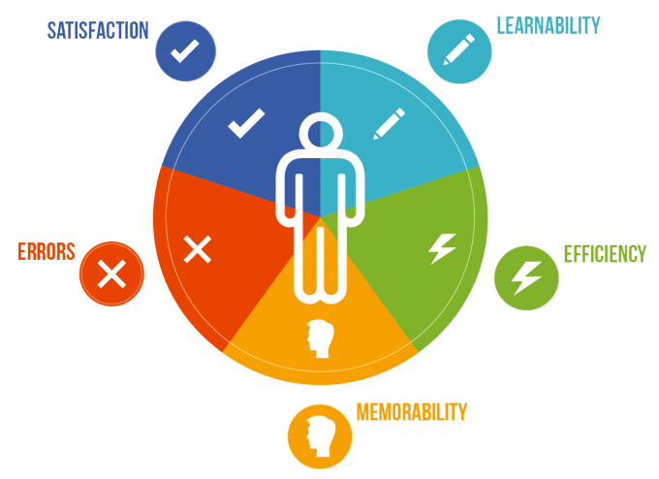
Acceptance Testing
Acceptance testing. Formal testing with respect to user needs, requirements, and business processes conducted to determine whether or not a system satisfies the acceptance criteria and to enable the user, customers or other authorised entity to determine whether or not to accept the system. (Textbook, p.55)

Slide 70
Acceptance Testing
Acceptance testing may produce information to assess the system’s readiness for deployment and use by the customer (end-user).
Defects may be found during acceptance testing, but finding defects is often not an objective, and finding a significant number of defects during acceptance testing may in some cases be considered a major project risk.

Slide 71

Acceptance Testing: UAT
Done by end-users
Focus: business processes
Environment: real / simulated operational environment
Aim: to build confidence that system will enable users to perform what they need to do with a minimum of difficulty, cost, and risk

Slide 72
User acceptance testing
Final stage of validation
Customer (user) should perform or be closely involved
Customer can perform any test they wish, usually based on their business processes
Final user sign-off
Approach
Mixture of scripted and unscripted testing
"Model Office" concept sometimes used

Slide 73
Why customer / user involvement
Users know:
what really happens in business situations
complexity of business relationships
how users would do their work using the system
variants to standard tasks (e.g. country-specific)
examples of real cases
how to identify sensible work-arounds
Benefit: detailed understanding of the new system

Slide 74
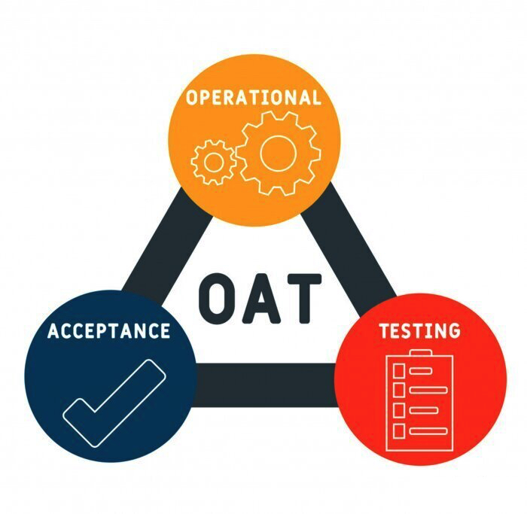
Acceptance Testing: OAT
Done by system admins
Focus: backups; installation, uninstallation upgrading; disaster recovery; user management; maintenance; data loading & migrations; security; performance
Environment: simulated production environment
Aim: to give confidence to the system admins that they will be able to keep the system running & recover from adverse events quickly and w/o additional risks.

Slide 75

Acceptance Testing: C/RAT
Contractual AT: to verify whether a system satisfies its contractual requirements. Performed by users / independent testers.
Regulatory AT: to verify whether a system conforms to relevant laws, policies and regulations. Performed by independent testers (possibly with a representative of regulatory body.

Slide 76
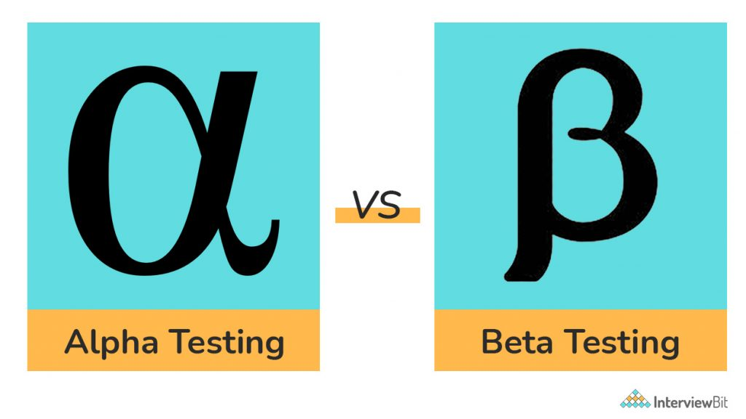
Acceptance Testing: Alpha & Beta Testing
Alpha testing. Simulated or actual operational testing conducted in the developer’s test environment, by roles outside the development organization.
Beta testing (field testing). Simulated or actual operational testing conducted at an external site, by roles outside the development organisation → diverse users; various environments → testing can cover more combinations of factors.

Slide 77
Acceptance Testing
Objectives | Establish confidence. Validate the system is complete & as expected. Verify functional & non-functional behaviours as specified.
Test Basis | Biz process. User/Biz reqs. Regulations, legal contract & standards. Use cases. System reqs. System/User documentation. Risk analysis reports. Backup & recovery procedures. Disaster recovery plan. Non-functional reqs. Operations doc. Performance targets. DB packages. Security standards.
Test Objects | SUT. System configuration & config data. Recovery system. Hot sits. Forms. Reports.
Typical Defects & Failures | System workflow. Business rules. Contract. Non-functional failures (security vulnerabilities, performance inefficiency, etc)

Slide 78
Acceptance testing motto
If you don't have patience to test the system, the system will surely test your patience.

Slide 79
CONTENT
Software Development Life Cycle Models
Test levels
Test types
Maintenance testing

Slide 80
Test Types
A test type is a group of test activities aimed at testing specific characteristics of a software system, or a part of a system, based on specific test objectives.
Test types
Functional testing
Non-functional testing
White-box testing
Change-related testing
Testing of function
Testing of software’s quality characteristics
Testing of software’s structure / architecture
Confirmation / Regression Test

Slide 81
[1] Functional Testing
The function of a system/component is "what" it does. Testing conducted to evaluate the compliance of a component/system with functional requirements.
Functional requirements may be described in work products such as:
Functional tests should be performed at all test levels, though the focus is different at each level
Can be done from 2 perspectives: requirement-based and business-process-based.
Business reqs specs Epics User stories | Use cases Functional specs They may be undocumented.

Slide 82
[1] Functional Testing
Functional requirements
a requirement that specifies a function that a system or system component must perform (ANSI/IEEE Std 729-1983, Software Engineering Terminology)
Functional specification
the document that describes in detail the characteristics of the product with regard to its intended capability (BS 4778 Part 2, BS 7925-1)

Slide 83
[1] Functional Testing: Requirements-based
Uses specification of requirements as the basis for identifying tests
Table of contents of the requirements spec provides an initial test inventory of test conditions
For each section / paragraph / topic / functional area,
risk analysis to identify most important / critical
decide how deeply to test each functional area

Slide 84
[1] Functional Testing: Business-process-based
Expected user profiles
what will be used most often?
what is critical to the business?
Business scenarios
typical business transactions (start to finish)
Use cases
prepared cases based on real situations

Slide 85
[1] Functional Testing: Coverage
Functional coverage is the extent to which some type of functional element has been exercised by tests, and is expressed as a percentage of the type(s) of element being covered.
Using traceability between tests and functional requirements, the percentage of these requirements which are addressed by testing can be calculated, potentially identifying coverage gaps.

Slide 86
[2] Non-functional Testing
Non-functional testing is the testing of "how well" the system behaves
Non-functional testing of a system evaluates characteristics of systems and software such as usability, performance, efficiency or security, etc.
Non-functional testing can be done at all test levels.
Defines expected results in terms of external behaviour → typically use black-box test techniques
BVA – stress conditions – performance testing
EP – types of devices – compatibility testing, or user groups – usability testing (novice, experienced, age range, geographical location, educational background)

Slide 87
[2] Non-functional Testing: Coverage
The thoroughness of non-functional testing can be measured by the coverage of non-functional elements.
If we had at least 1 test for each major group of users, we would have 100% coverage of those user groups identified.
Traceability between non-functional tests and non-functional requirements, we can identify coverage gaps
E.g., an implicit requirement is for accessibility for disabled users

Slide 88
Performance Tests
Timing Tests
Response and service times
Database back-up times
Capacity & Volume Tests
Maximum amount or processing rate
Number of records on the system
Graceful degradation
Endurance Tests (24-hr operation?)
Robustness of the system
Memory allocation

Slide 89



Performance testing: Example
Task: Server should respond in less than 2 sec when up to 100 users access it concurrently. Server should respond in less than 5 sec when up to 300 users access it concurrently.
Performance Testing Procedure: emulate different amount of requests to server in range (0; 300), for instance, measure time for 10, 50, 100, 240 and 290 concurrent users.
Defect: starting from 200
Concurrent requests
respond time is 10-15 seconds.
Notes:
Performance testing is a type of performance testing to determine how efficiently a product handles a variety of events.
Ex: Measuring the response time of a website, or a specific element
Tester needs to check product’s speed, scalability and stability
Speed : Need to verify that application response is getting quick or not.
Scalability : Need to verify that application can handle maximum user load.
Stability : Need to verify that application is stable under varying load.

Slide 90
Multi-User Tests
Concurrency Tests
Small numbers, large benefits
Detect record locking problems
Load Tests
The measurement of system behaviour under realistic multi-user load
Stress Tests
Go beyond limits for the system - know what will happen
Particular relevance for e-commerce
Source: Sue Atkins, Magic Performance Management

Slide 91

Load testing: Example
Task: Server should allow up to 500 concurrent connections.
Load Testing Procedure: emulate different amount of requests to server close to pick value, for instance, measure time for 400, 450, 500 concurrent users.
Defect: Server returns “Request
Time Out” starting from 490
concurrent requests.

Slide 92


Stress testing: Example
Task: Server should allow up to 500 concurrent connections.
Stress Testing Procedure: emulate amount of requests to server greater than pick value, for instance, check system behavior for 500, 510, and 550 concurrent users.
Defect: Server crashes starting
from 500 concurrent requests
and user’s data is lost.
Data should not be lost even in
stress situations. If possible,
system crash also should be avoided.

Slide 93
Usability Tests
Messages tailored and meaningful to (real) users?
Coherent and consistent interface?
Sufficient redundancy of critical information?
Within the "human envelope"? (7±2 choices)
Feedback (wait messages)?
Clear mappings (how to escape)?
Who should design / perform these tests?

Slide 94
Security Tests
Passwords
Encryption
Hardware permission devices
Levels of access to information
Authorisation
Covert channels
Physical security

Slide 95
Configuration and Installation
Configuration Tests
Different hardware or software environment
Configuration of the system itself
Upgrade paths - may conflict
Installation Tests
Distribution (CD, network, etc.) and timings
Physical aspects: electromagnetic fields, heat, humidity, motion, chemicals, power supplies
Uninstall (removing installation)

Slide 96
Reliability / Qualities
Reliability
"System will be reliable" - how to test this?
"2 failures per year over ten years"
Mean Time Between Failures (MTBF)
Reliability growth models
Other Qualities
Maintainability, Portability, Adaptability, etc.

Slide 97
Back-up and Recovery
Back-ups
Computer functions
Manual procedures (where are tapes stored)
Recovery
Real test of back-up
Manual procedures unfamiliar
Should be regularly rehearsed
Documentation should be detailed, clear and thorough

Slide 98
Documentation Testing
Documentation review
check for accuracy against other documents
gain consensus about content
documentation exists, in right format
Documentation tests
is it usable? does it work?
user manual
maintenance documentation

Slide 99
[3] White-box Testing
White-box testing derives tests based on the system’s internal structure or implementation of the component or system.
Internal structure may include code, architecture, work flows, and/or data flows within the system.
Can occurs at any test level; but
tends to mostly at component testing and component integration testing
Generally less likely at higher test levels, except for business process testing (test basis could be business rules)

Slide 100
[3] White-box Testing: Coverage
Structural coverage is the extent to which some type of structural element has been exercised by tests, expressed as a percentage of the type of element being covered.
At the component testing level, code coverage is based on the percentage of executable elements (e.g., statements or decision outcomes)
At the component integration testing level, white-box testing may be based on the architecture of the system (e.g., interface between components), and coverage may be measured by percentage of interfaces exercised by tests.

Slide 101
[4] Change-related Testing
When changes are made to a system, testing should be done to confirm that the changes have corrected the defect or implemented the functionality correctly, and have not caused any unforeseen adverse consequences.
Two sub-types: Confirmation testing and Regression testing

Slide 102
[4] Change-related Testing: Confirmation Testing
After a defect is fixed, the software should be re-tested.
At the very least, the steps to reproduce the failure(s) caused by the defect must be re-executed on the new software version.
The purpose of a confirmation test is to confirm whether the original defect has been successfully fixed.

Slide 103

[4] Change-related Testing: Regression Testing
It is possible that a change made in one part of the code, may accidentally affect the behaviour of other parts of the code
Changes may include changes to the environment
Regression testing involves running tests to detect such unintended side-effects.

Slide 104
[4] Change-related Testing: Regression Testing
Regression test suites are run many times and generally evolve slowly, so regression testing is a strong candidate for automation.
Automation of these tests should start early in the project.
Change-related testing is performed at all test levels.
Regression testing = find new bugs.
Retesting = confirm bugs were fixed.
Regression testing locates bugs after updates or changes to the code or UI.
Retesting makes sure that a bug that was found and addressed by a developer was actually fixed

Slide 105
Test Types & Test Levels
 | Functional Test | Non-functional Test
Component | How components calculate compound interest | Time to perform a complex interest calculation
Component Integration | How account info from user interface is passed to the business logic | Check for buffer overflow from data passed from the UI to business logic
System | How account holders can apply for a line of credit | Portability tests of presentation layer on browsers & mobiles
System Integration | How system uses an external microservice to check an account holder’s credit score | Reliability tests (robustness) if the microservice does not respond
Acceptance | How banker handles a credit application | Usability tests (accessibility) for banker’s credit processing interface for the disabled

Slide 106
Test Types & Test Levels
 | White-box Test | Change-related Test
Component | 100% statement & decision coverage for all financial calculations components | Automated regression tests for each component are included in CI framework & pipeline
Component Integration | Coverage of how each screen in the browser interface passes data to the next screen in biz logic | Confirmation tests for interface-related defects are activated as fixes are checked in
System | Coverage of web page sequence during a credit line application | All tests for a given workflow are re-executed if any screen changes
System Integration | Coverage of all possible inquiry types sent to the credit score microservice | Automated tests of interactions of system with microservice are re-executed as the service is changed
Acceptance | Coverage of all supported financial data file structures & value ranges for bank-to-bank transfers | Previously failed tests are re-executed after defects found are fixed

Slide 107
CONTENT
Software Development Life Cycle Models
Test levels
Test types
Maintenance testing

Slide 108
Maintenance testing
Testing to preserve quality:
Different sequence
Development testing executed bottom-up
Maintenance testing executed top-down
Different test data (live profile)
Breadth tests to establish overall confidence
Depth tests to investigate changes and critical areas
Predominantly regression testing

Slide 109
What to test in maintenance testing
Triggers for maintenance: Modification – Migration – Retirement
Impact analysis
What could this change have an impact on?
How important is a fault in the impacted area?
Test what has been affected, but how much?
Most important affected areas?
Areas most likely to be affected?
Whole system?
The answer: "It depends"

Slide 110
Poor or missing specifications
Consider what the system should do
talk with users
Document your assumptions
ensure other people have the opportunity to review them
Improve the current situation
document what you do know and find out
Track cost of working with poor specifications
to make business case for better specifications

Slide 111
What should the system do?
Alternatives
the way the system works now must be right (except for the specific change)
use existing system as the baseline for regression tests
look in user manuals or guides (if they exist)
ask the experts - the current users
Without a specification, you cannot really test, only explore. You can validate, but not verify.

Slide 112
Summary: Key Points
V-model shows test levels, early test design
High level test planning
Component testing using the standard
Integration testing in the small: strategies
System testing (non-functional and functional)
Integration testing in the large
Acceptance testing: user responsibility
Maintenance testing to preserve quality
1
2
3
ISTQB / ISEB Foundation Exam Practice
4
5
6

